Slide 1
Name-Shashank Yadav
Introduction
Class-5B
Topic-My City
School-Raj English School
Teacher name-Sunidhi Singh

Slide 2
My City Name is Varanasi.
Varanasi is also known as Banaras or Banares or Kashi.
The official name of Varanasi is not a modern name. It is possibly based on the fact that it lies between where the Varuna River, to the north, and the river Assi, to the south, flow into the river Ganga . The name Varanasi was spelt Baranasi in Pali, which ultimately gave birth to the name Banaras.
Kashi is the spiritual name of the northern Indian city of Varanasi, the holiest of cities in Hinduism. Its name translates as “city of light” or “shining city” and comes from the Sanskrit word, prakasa, meaning “light.”
Hindus also believe that dying in Kashi may release them from the life-death-rebirth cycle, or samsara.

Slide 3
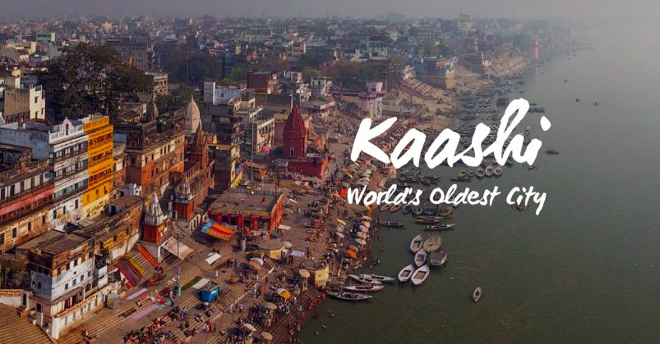
Varanasi is oldest city in the world.

Slide 4

Varanasi is also famous for its Banarasi silk saris.
A banarasi silk saree is a trend in itself. The designs and zari work are famous worldwide.
Varanasi developed as an important manufacturing centre, noted for its muslin and silk fabrics, perfumes, ivory works, and sculpture.

Slide 5
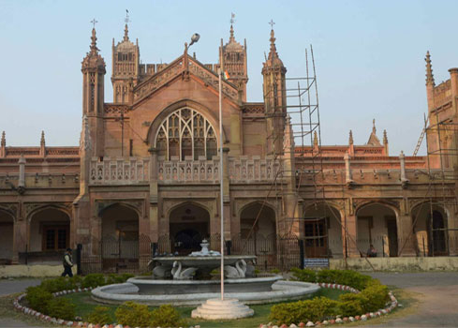
Varanasi is also known as Sanskrit city in world.
Varanasi has the maximum number of Sanskrit schools as well as the highest number of students studying Sanskrit. There are more than 110 Sanskrit schools that are functional in Varanasi.

Slide 6
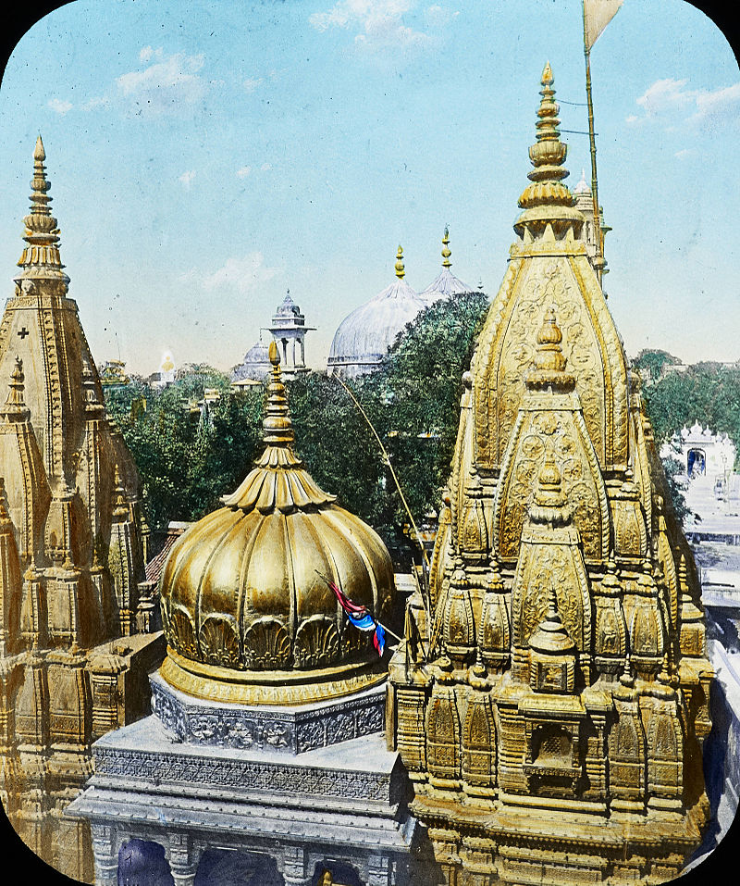
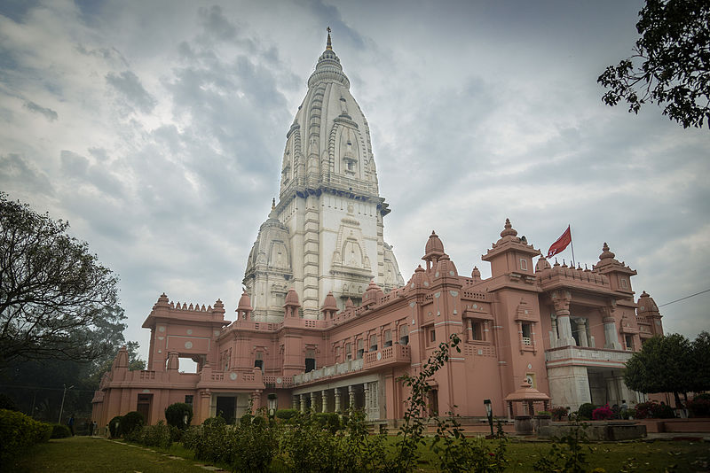
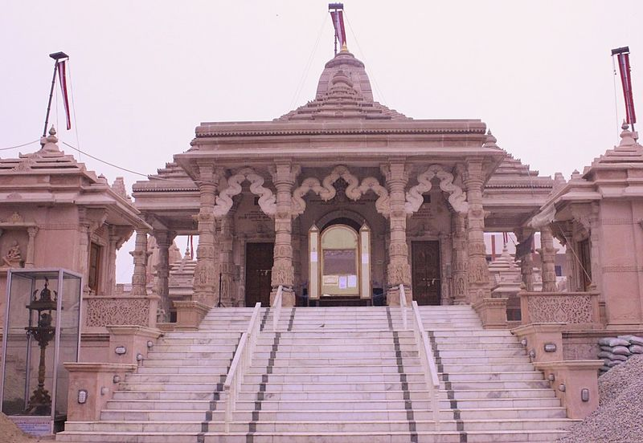
Varanasi is described as the City of Temples.
Kashi Vishwanath Temple
Shri Vishwanath Mandir
Parshvanath Jain temple

Slide 7
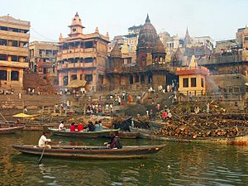
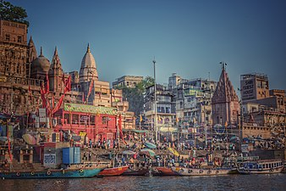
The Ghats in Varanasi are world-renowned banks made in steps of stone slabs along the river bank where pilgrims make ritual ablutions.
Manikarnika Ghat
Dashashwamedh Ghat

Slide 8
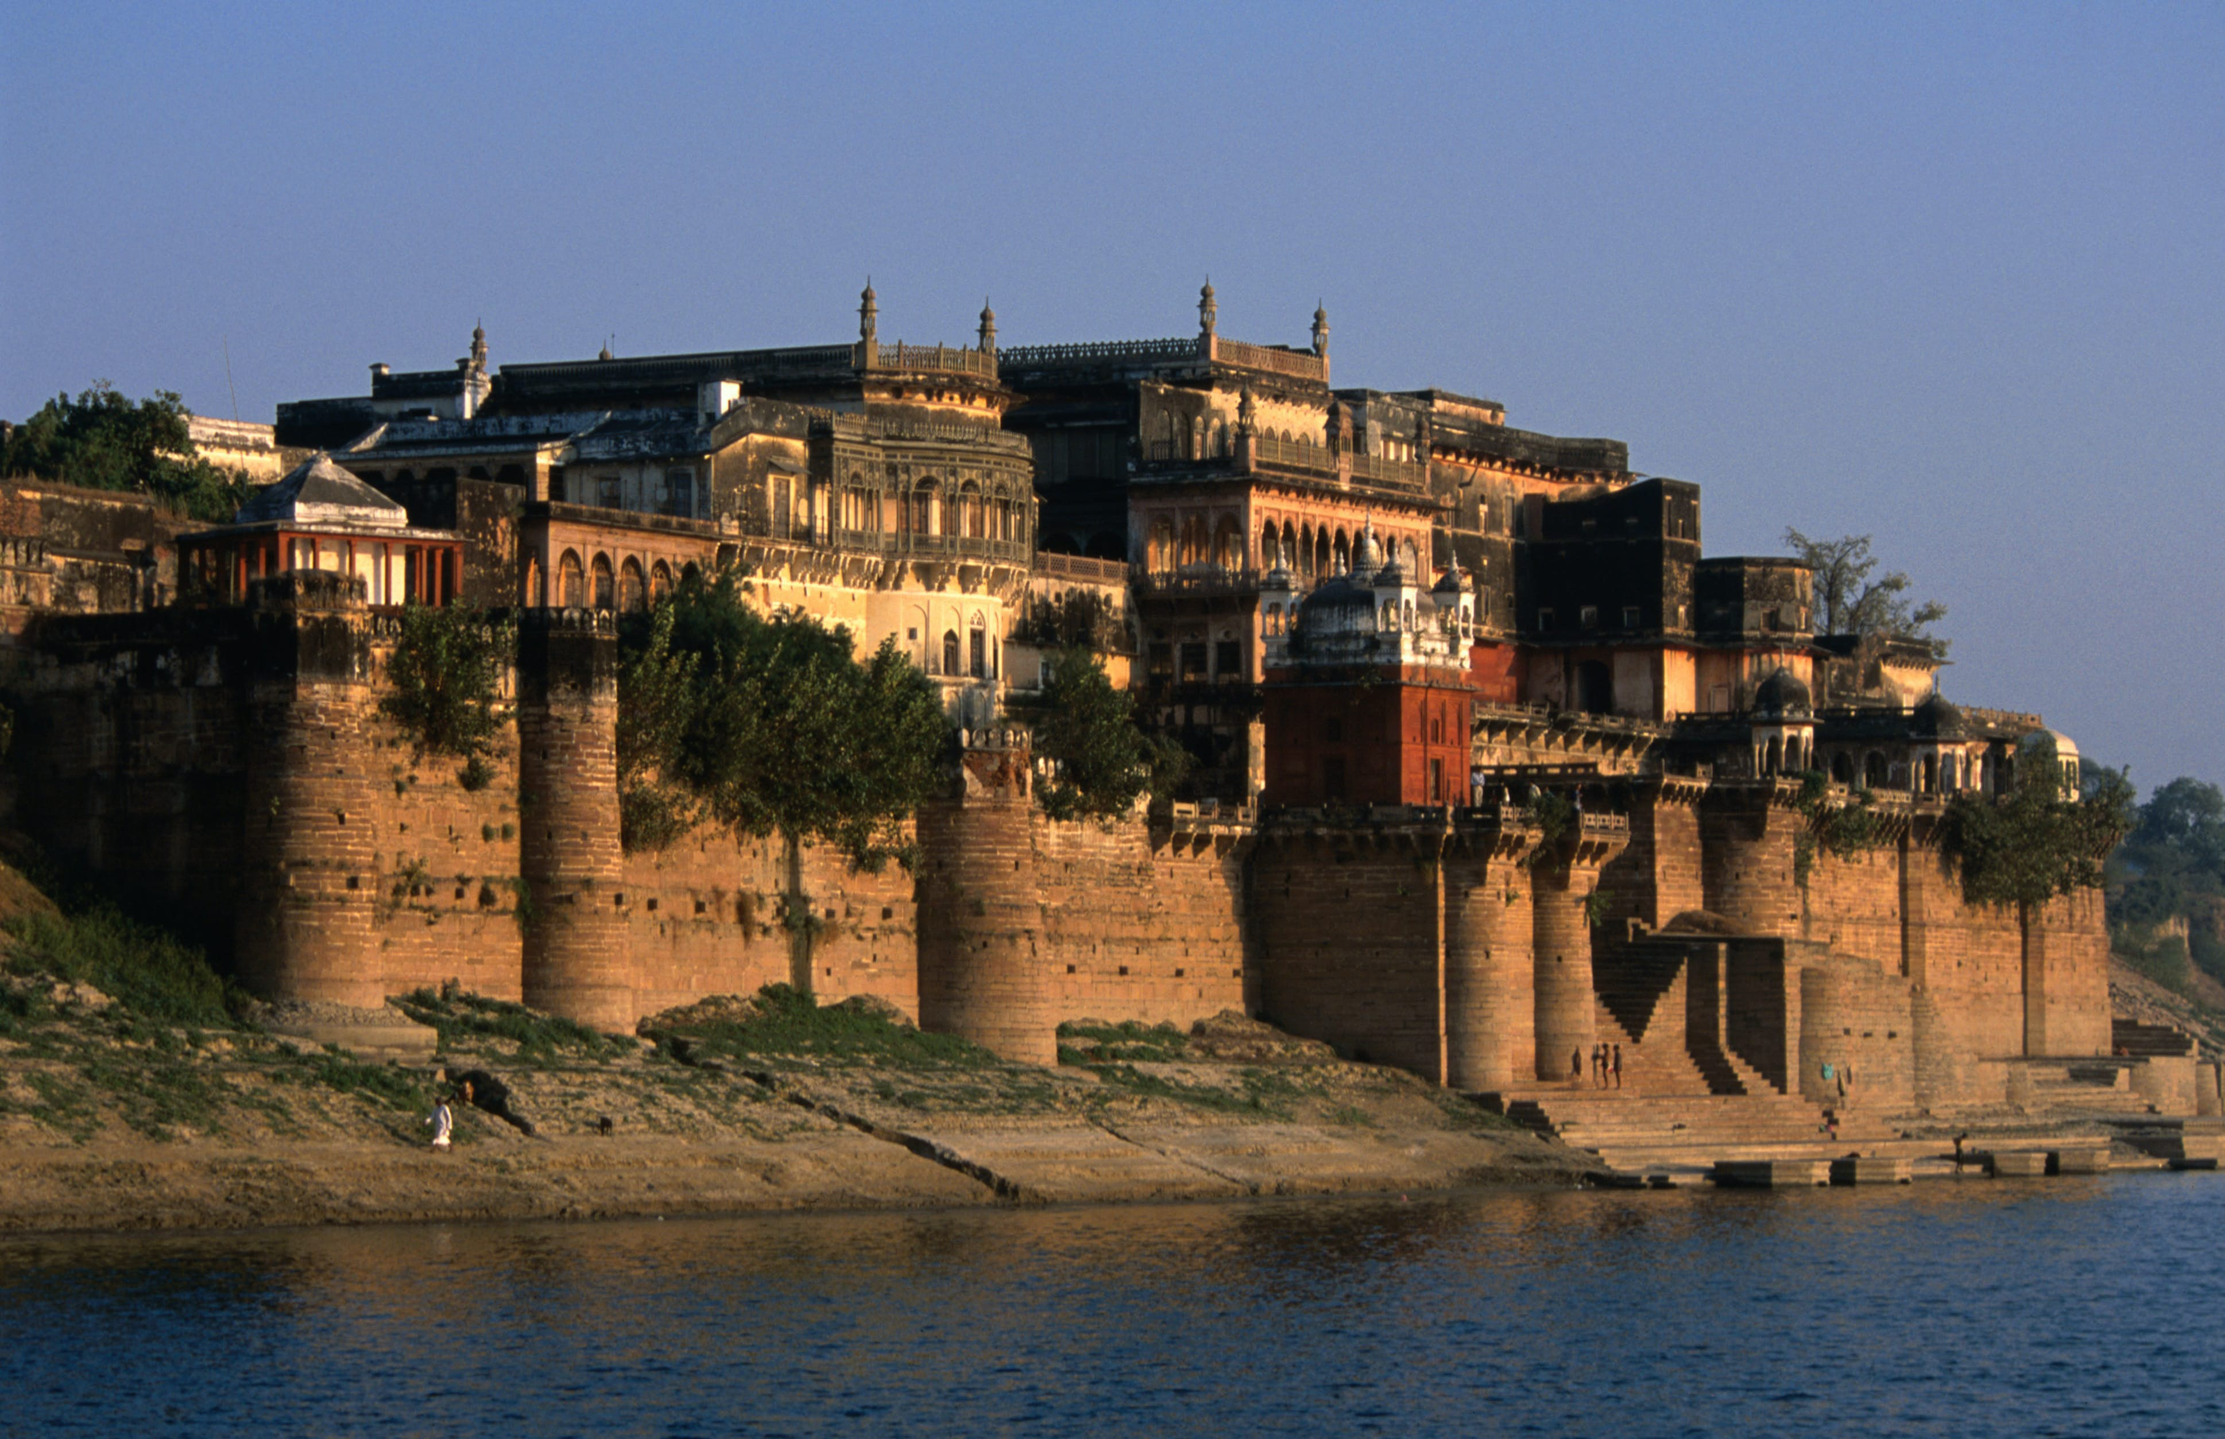
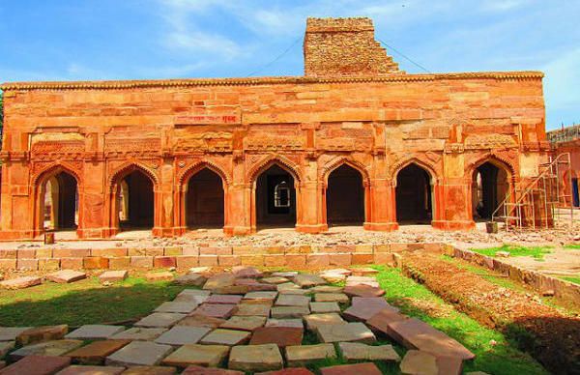
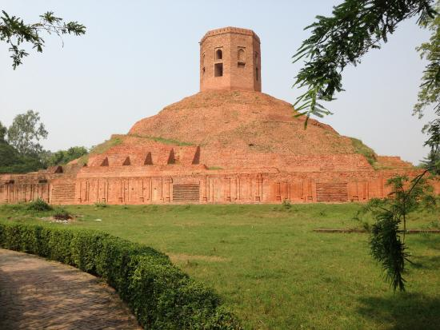
Tourism
Tourism is Varanasi's second most important industry.
Domestic tourist most commonly visit for religious purposes while foreign tourist visit for ghats along River Ganges and Sarnath.
The prominent malls and multiplexes in Varanasi are JHV Mall in the Cantonment area, IP Mall in Sigra, IP Vijaya Mall in Bhelupur, Vinayak Plaza in Maldhaiya and PDR Mall in Luxa.
Fort--------→ 1. Ramnagar Fort
2. Chunar Fort
Waterfalls → 1. Devdari
2. Lakhniadari
3. Rajdari

Slide 9
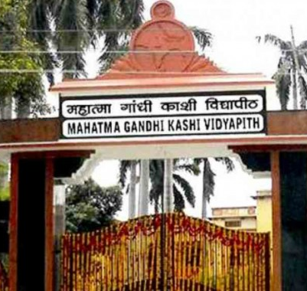
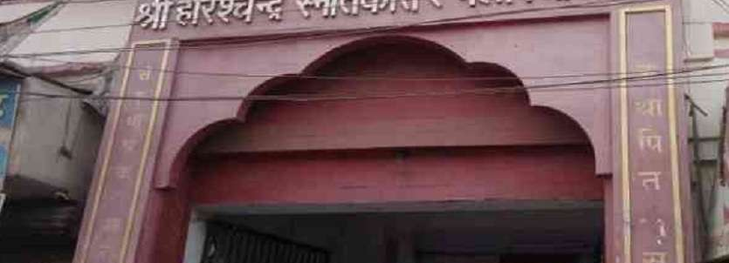
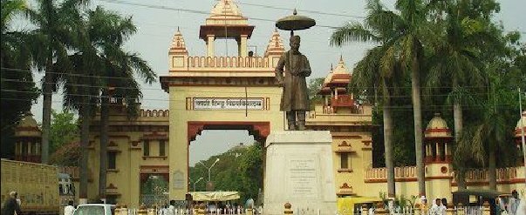
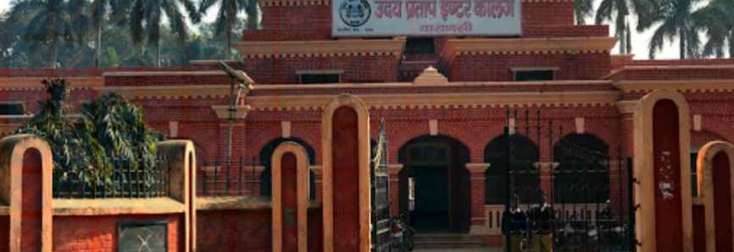
Universities Of Varanasi
Banaras Hindu University
Mahatma Gandhi Kashi University
IIT BHU
Udai Pratap Autonomous College
Sampurnand Sanskrit University
Agrasen Kanya Mahavidhyalay
D.A.V Degree College
HarishChand P.G College
Etc.

Slide 10
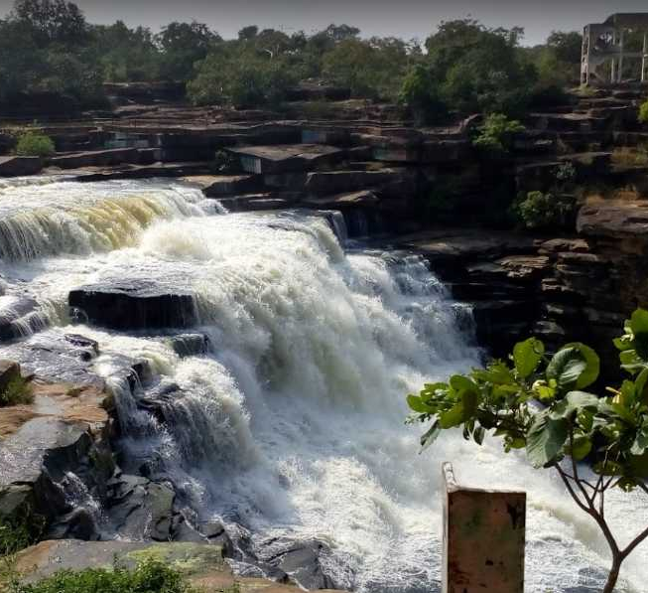
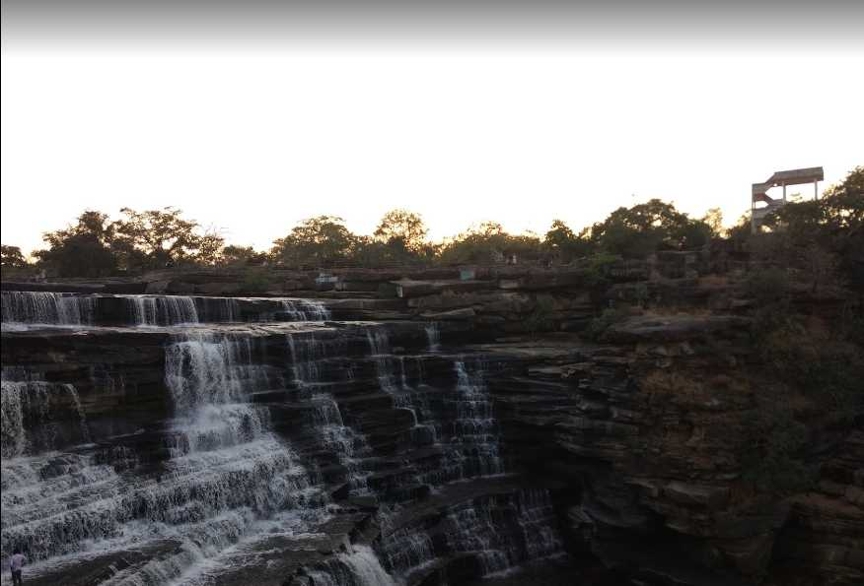
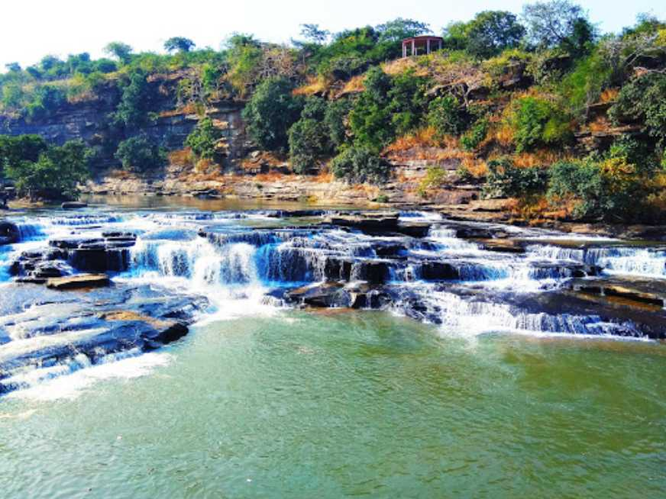
Waterfalls of Varanasi
Devdari Waterfall
Rajdari Waterfall
Lakhaniyadari Waterfall

Slide 11
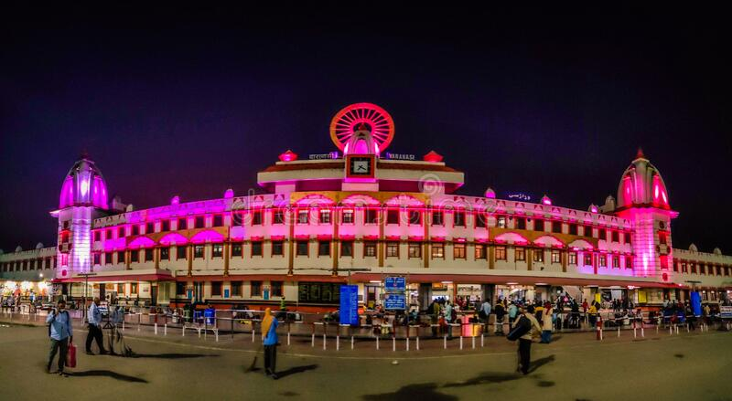
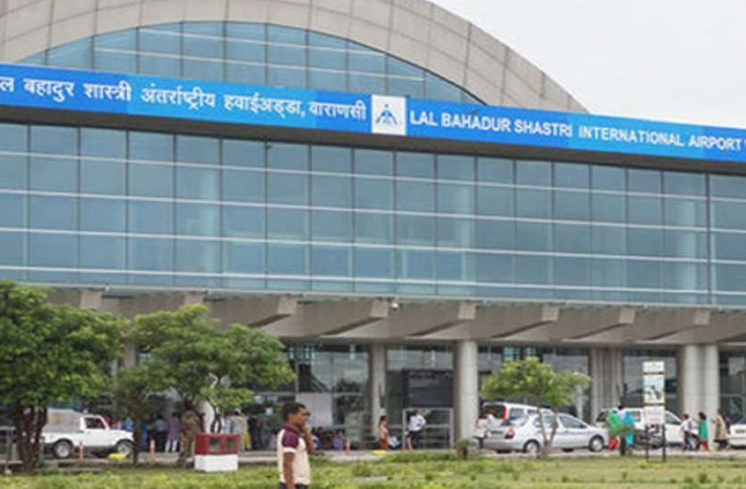
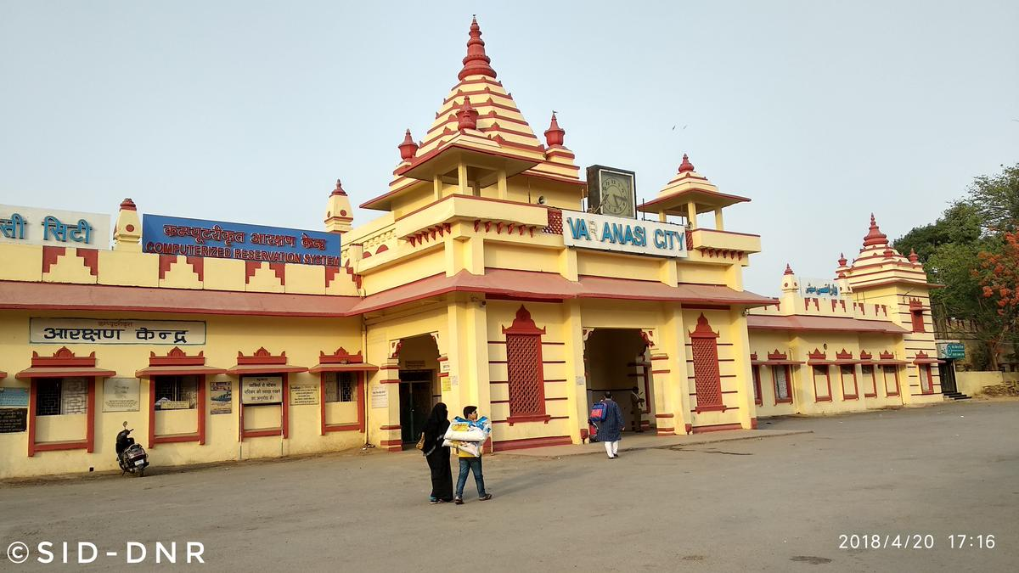
Transportation of Varanasi
Railway Station-
1. Manduadih Train Station
2. Cantt railway station
3. Mughal Sarai junction
4. Bhulanpur Station
5. Railway Crossing (Ashapur) Etc.
Air Port
Lal Bahudar Shastri Airport is an international airport in Babatpur, 26km northwest of Varanasi.
Bus Station
1. Chaudhary Charan Singh Bus Stand
2. Pandeypur Bus Stop
3. Lanka Bus Stop.
4.Cantt Bus Station Etc.

Slide 12
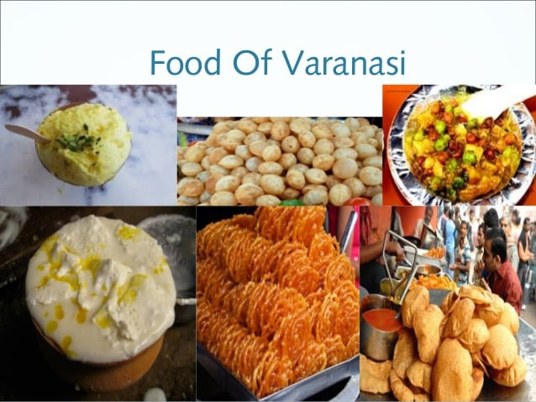

Slide 13
Thanks

